Slide 1


Slide 2


Lhasa Gen AI POC.
From simple retrieval augmented generation to Agentic RAG

Slide 3
01
02
03
04
05
06
07
08
Introduction
Knowledge Base for unstructured data
Structured data exploration agent
RAG Fusion
RAG Fusion combined
Agentic RAG
Testing framework
What’s next?
Notes:
Agenda
General Template Guidance: Information to help you make good presentations.
Standard / Static Slides: Some key Endava slides/lockups that, in general, should only be modified by marketing.
Template Slides: A selection of template slides for use in Endava presentations.
Larger Format Template Slides: Template slides with larger content.
Icon Library: A selection of hundreds of icons to use in Endava presentations.

Slide 4

Introduction
Build a Retrieval Augmented Generation system for unstructured (literature) and structured (Vitic DB) content from Lhasa.
Cosmetic Ingredient Review documents
Vitic is an advanced, structure-searchable chemical toxicity database designed to support chemical risk assessments across the pharmaceutical, cosmetic, and agrochemical industries.
DOI – Journal papers
PUBMED articles
Vitic contains over 574,000 expertly curated and peer-reviewed data records, including information on carcinogenicity, genotoxicity, and skin sensitisation.
Scientific Committee on Consumer Safety documents
Zotero-Papers documents
Notes:
Presentation Matters
This slide provides justification for caring about how your presentations look and feel.
It can also be used as a template slide. Change the header (and footer) to reflect the client, presentation name, and chapter title. To change the header and footer, click “edit master” and change the header and footer on all the master slides to have the same client and presentation name across all pages.

Slide 5
Introduction
Process
Quick
prototype
Build with Amazon Bedrock
Build for Production
Evaluate
Optimize
LangChain
LangGraph
SageMaker Studio
Bedrock Agents
Agents collaboration
Action Groups
Lambda invoke Bedrock Agents
Step Functions orchestration
Benckmark tests
Testing framework
System prompts optimization
Data Scientists feedback
Refined flow (e.g. RAG Fusion -> Agentic RAG)
Notes:
Presentation Matters
This slide provides justification for caring about how your presentations look and feel.
It can also be used as a template slide. Change the header (and footer) to reflect the client, presentation name, and chapter title. To change the header and footer, click “edit master” and change the header and footer on all the master slides to have the same client and presentation name across all pages.

Slide 6
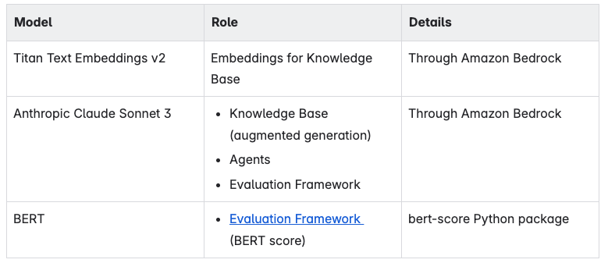
Knowledge Base for unstructured data
Data
Models
Cosmetic Ingredient Review documents
6,551
DOI – Journal papers
345
PUBMED articles
255,978
Scientific Committee on Consumer Safety documents
66
Zotero-Papers documents
7,647
Knowledge Base
OpenSearch serverless Vector Database service
Titan Text Embeddings v2 embedding model, floating point embeddings, 1024 vector dimension
Data source: S3, indexed 129,952 files, 121,263 metadata (40 GB). 300 tokens chunks, 20% superposition.
Anthropic Claude 3 Sonnet model (28K context window) model used with the Knowledge Base agent.
Notes:
Presentation Matters
This slide provides justification for caring about how your presentations look and feel.
It can also be used as a template slide. Change the header (and footer) to reflect the client, presentation name, and chapter title. To change the header and footer, click “edit master” and change the header and footer on all the master slides to have the same client and presentation name across all pages.

Slide 7
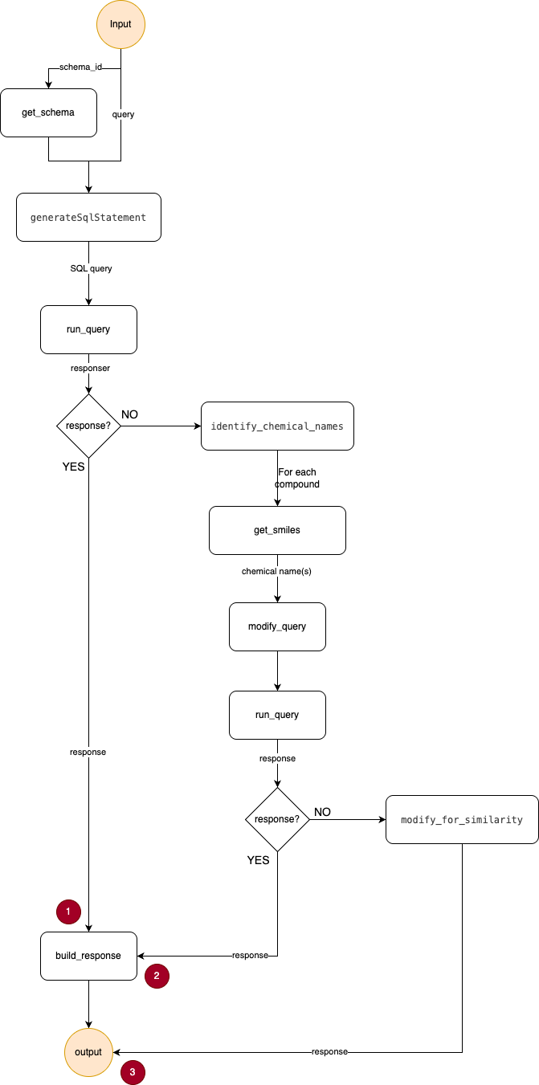
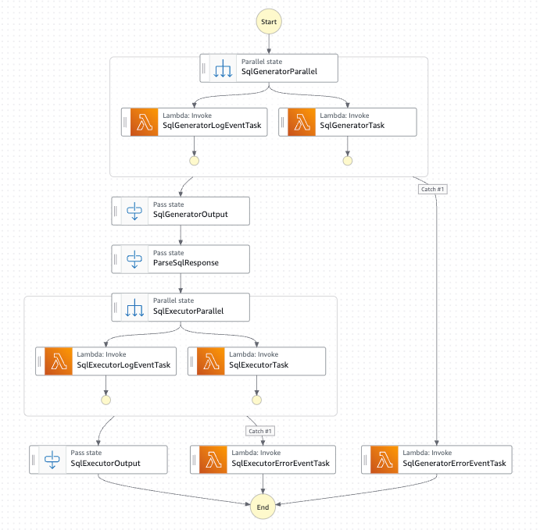
Structured Data Exploration agent
Notes:
Presentation Matters
This slide provides justification for caring about how your presentations look and feel.
It can also be used as a template slide. Change the header (and footer) to reflect the client, presentation name, and chapter title. To change the header and footer, click “edit master” and change the header and footer on all the master slides to have the same client and presentation name across all pages.

Slide 8
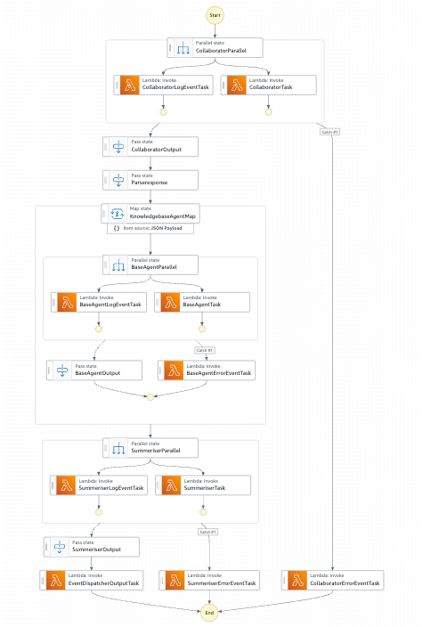
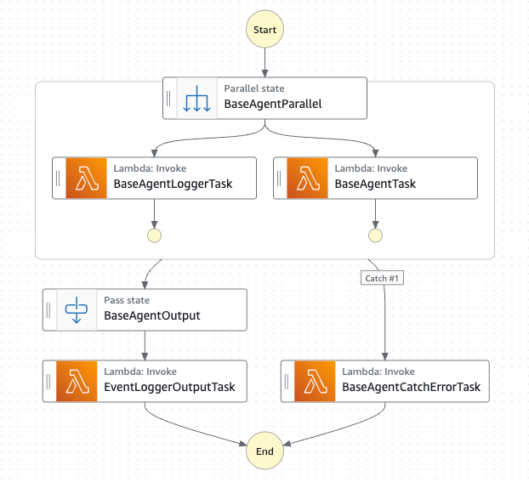
RAG Fusion
Notes:
Presentation Matters
This slide provides justification for caring about how your presentations look and feel.
It can also be used as a template slide. Change the header (and footer) to reflect the client, presentation name, and chapter title. To change the header and footer, click “edit master” and change the header and footer on all the master slides to have the same client and presentation name across all pages.

Slide 9
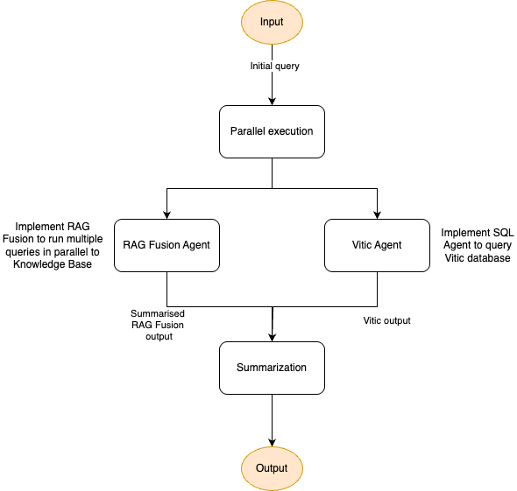
RAG Fusion combined
Notes:
Presentation Matters
This slide provides justification for caring about how your presentations look and feel.
It can also be used as a template slide. Change the header (and footer) to reflect the client, presentation name, and chapter title. To change the header and footer, click “edit master” and change the header and footer on all the master slides to have the same client and presentation name across all pages.

Slide 10
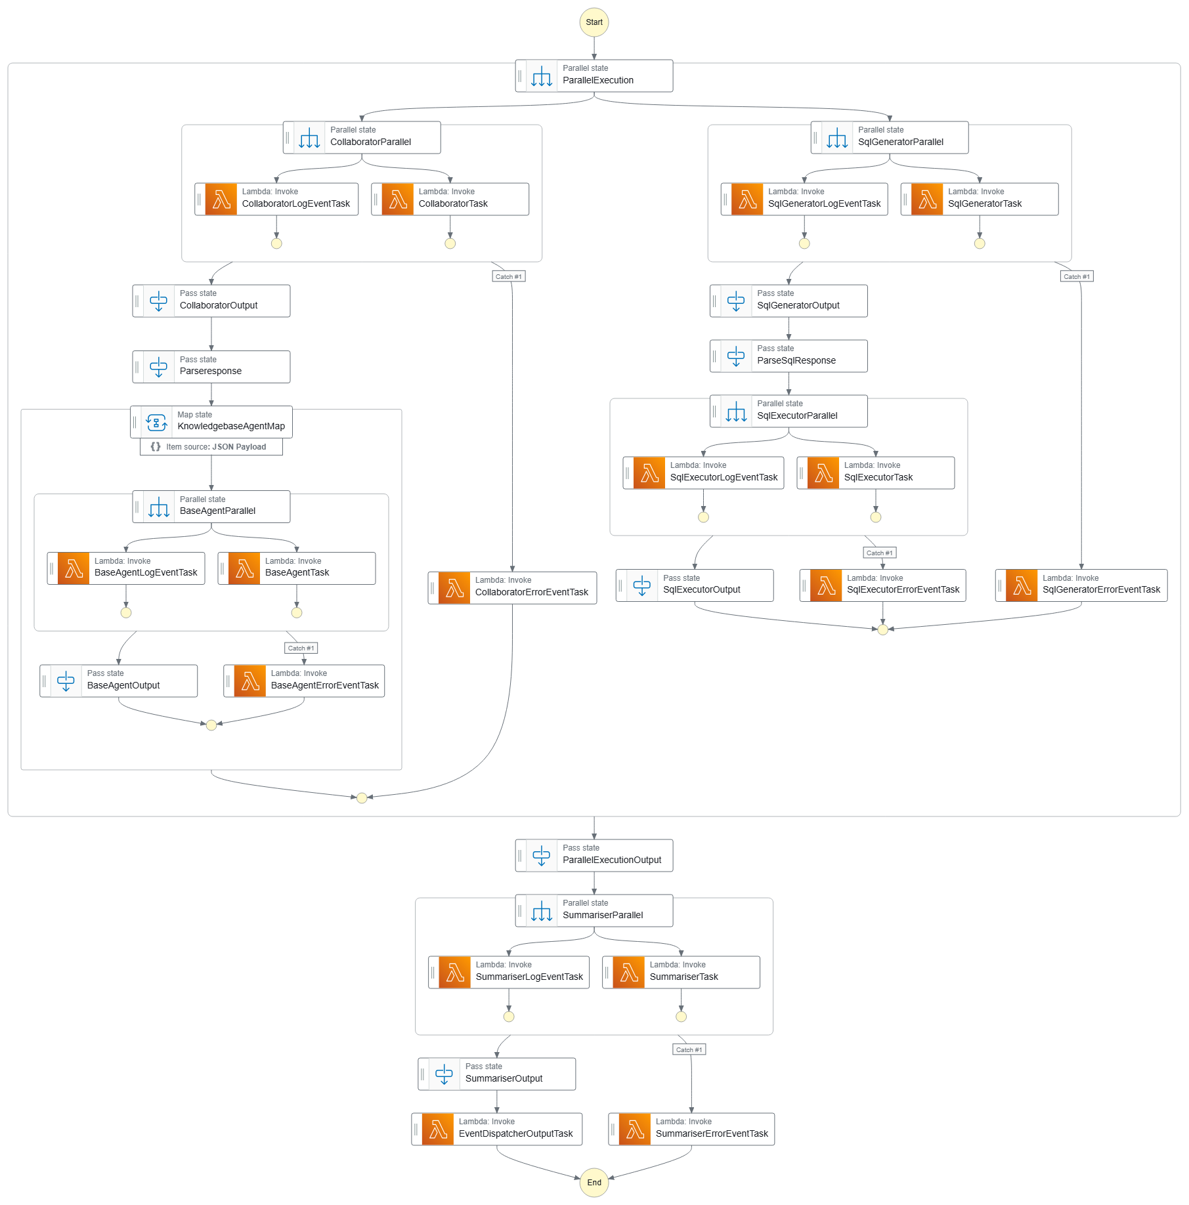
RAG Fusion combined
Notes:
Presentation Matters
This slide provides justification for caring about how your presentations look and feel.
It can also be used as a template slide. Change the header (and footer) to reflect the client, presentation name, and chapter title. To change the header and footer, click “edit master” and change the header and footer on all the master slides to have the same client and presentation name across all pages.

Slide 11
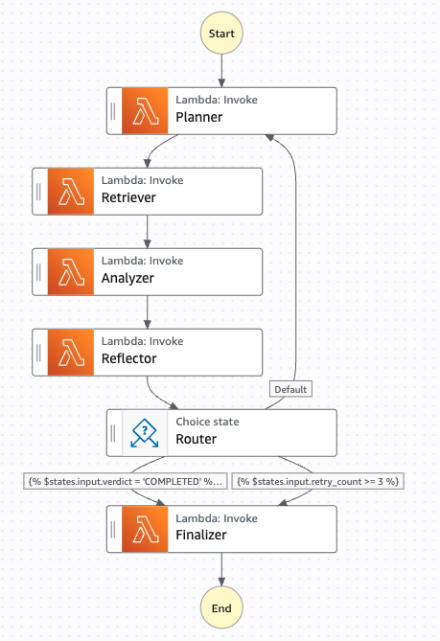
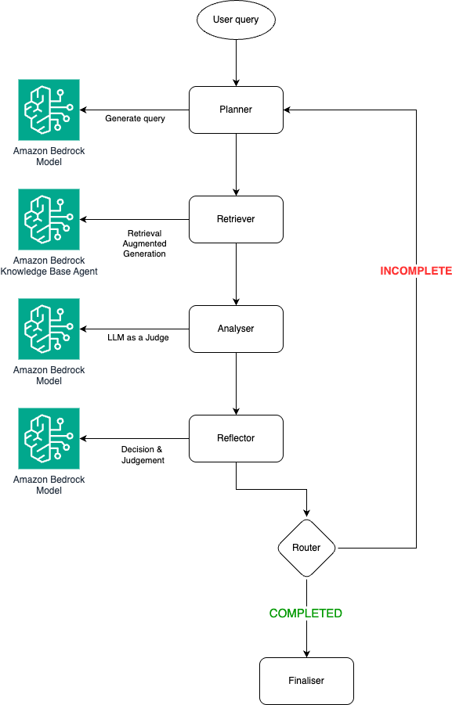
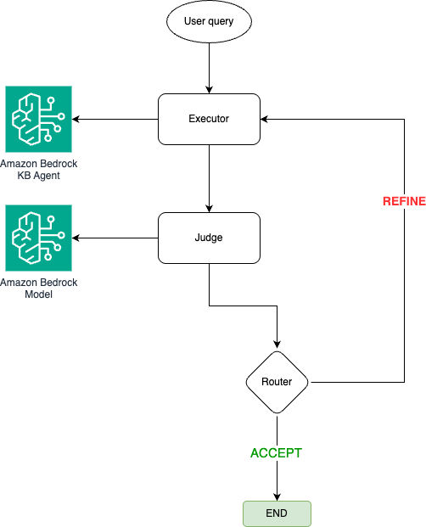
Agentic RAG
Notes:
Presentation Matters
This slide provides justification for caring about how your presentations look and feel.
It can also be used as a template slide. Change the header (and footer) to reflect the client, presentation name, and chapter title. To change the header and footer, click “edit master” and change the header and footer on all the master slides to have the same client and presentation name across all pages.

Slide 12
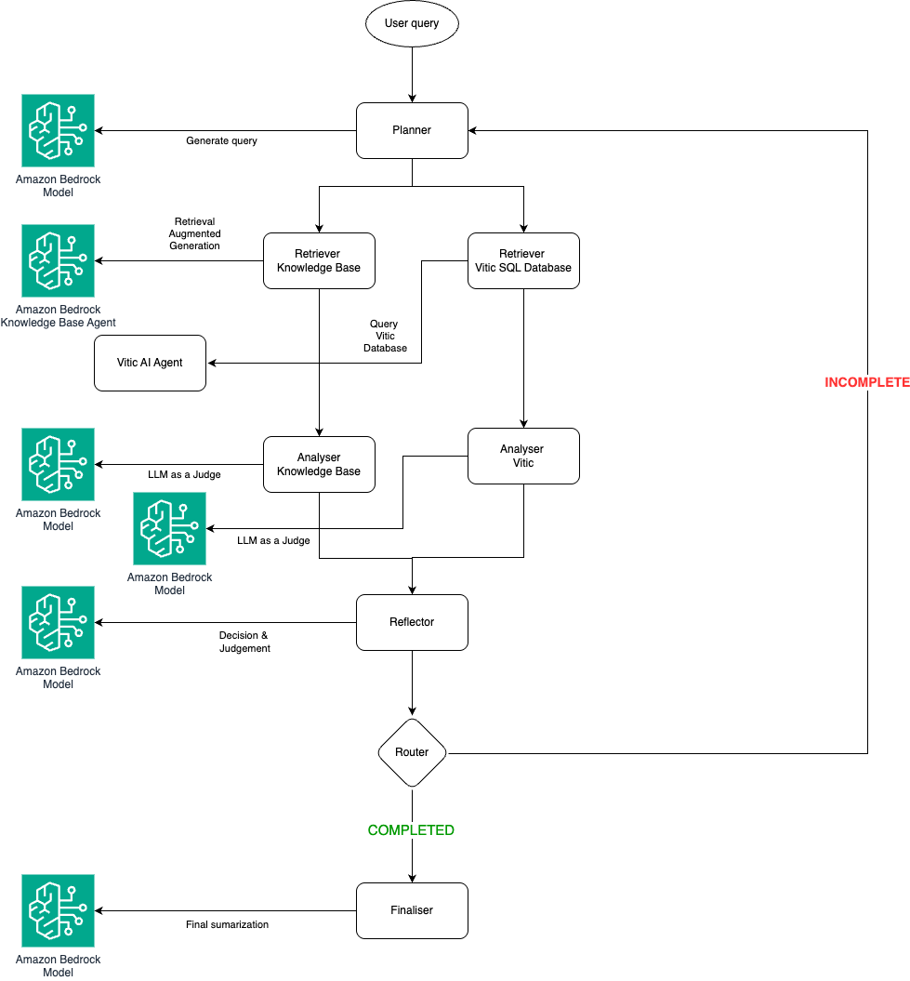
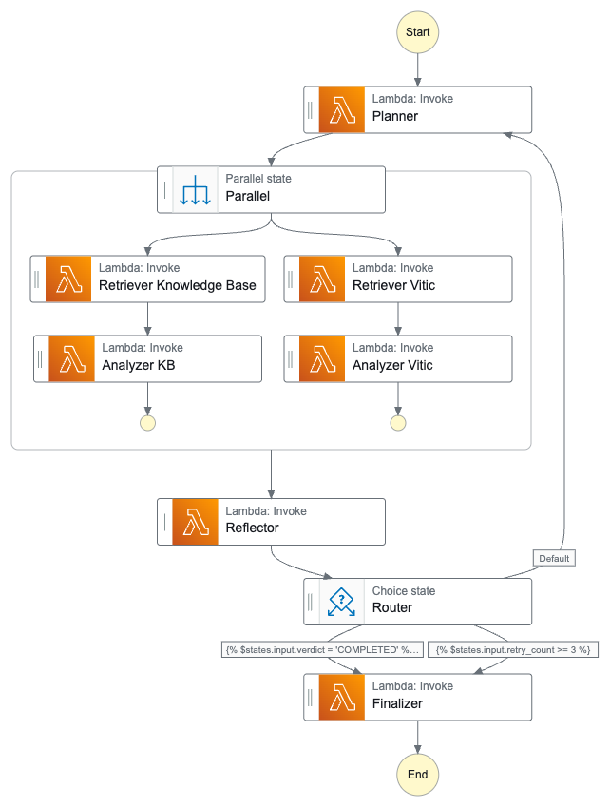
Agentic RAG
Notes:
Presentation Matters
This slide provides justification for caring about how your presentations look and feel.
It can also be used as a template slide. Change the header (and footer) to reflect the client, presentation name, and chapter title. To change the header and footer, click “edit master” and change the header and footer on all the master slides to have the same client and presentation name across all pages.

Slide 13
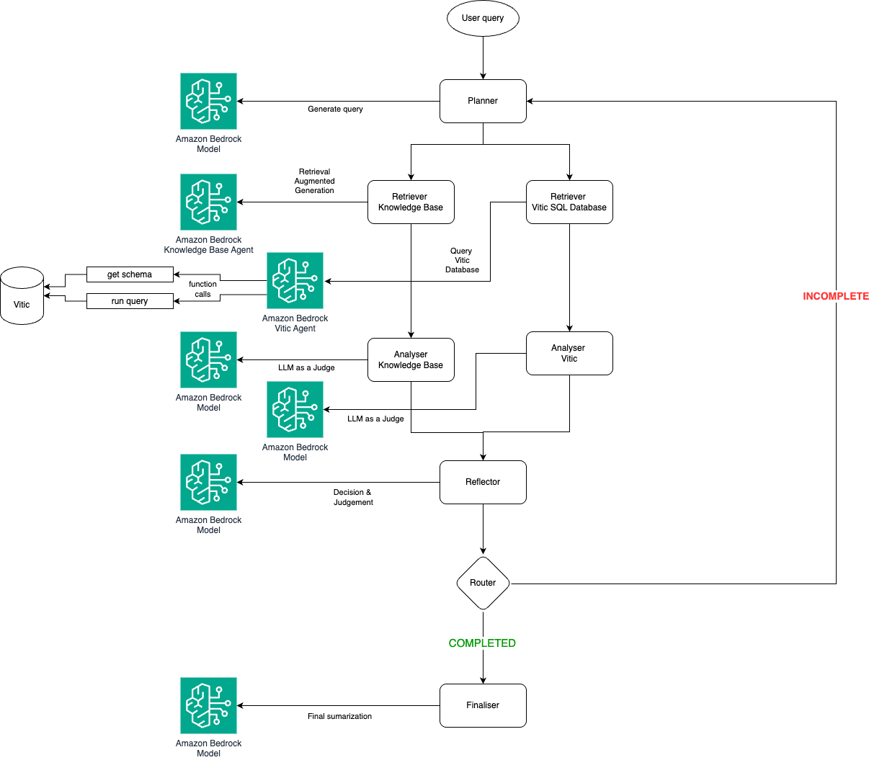
Agentic RAG
Notes:
Presentation Matters
This slide provides justification for caring about how your presentations look and feel.
It can also be used as a template slide. Change the header (and footer) to reflect the client, presentation name, and chapter title. To change the header and footer, click “edit master” and change the header and footer on all the master slides to have the same client and presentation name across all pages.

Slide 14
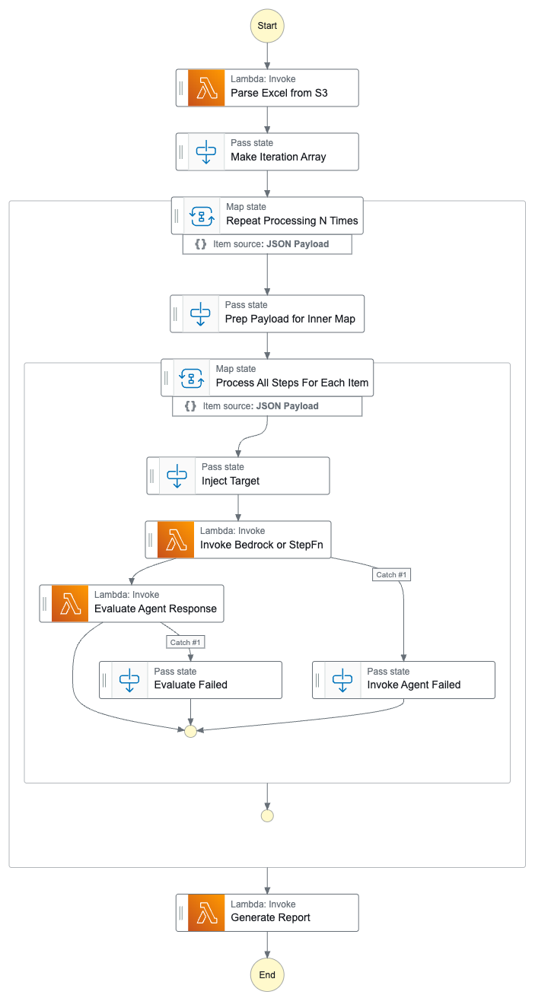
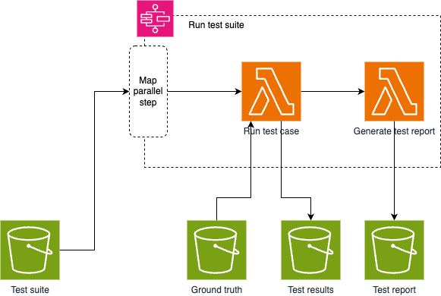
Testing framework
METRICS
EXAMPLE USE
Rouge Metric
BERT Score
Bias
Toxicity
Faithfulness
Answer Relevancy
Contextual Precision
Contextual Recall
Contextual Relevancy
{
"key": "test-suites/dp-test-suite-2.xlsx",
"target": {
"stepFunctionArn": "arn:aws:states:eu-west-2:420498525515:stateMachine:CombinedRagFusionChatRagFusionChatStateMachine7FADB45B-TcTnLbpEm5Ns",
"metric": "BERT Score"
}
}
TARGETS
Lambda
Step Function
Bedrock Agent
Notes:
Presentation Matters
This slide provides justification for caring about how your presentations look and feel.
It can also be used as a template slide. Change the header (and footer) to reflect the client, presentation name, and chapter title. To change the header and footer, click “edit master” and change the header and footer on all the master slides to have the same client and presentation name across all pages.

Slide 15
What’s next?
UAT / Production
System prompt improvements
Evolving testing framework (adopt RAGAS, SQL-specific metrics)
Agentic approach for both structured & unstructured data ( reflection, tools discovery)
Knowledge base optimization (chunking, embeddings, vector DB type)
Graph RAG (to leverage metadata)
Notes:
Presentation Matters
This slide provides justification for caring about how your presentations look and feel.
It can also be used as a template slide. Change the header (and footer) to reflect the client, presentation name, and chapter title. To change the header and footer, click “edit master” and change the header and footer on all the master slides to have the same client and presentation name across all pages.

